Slide 1
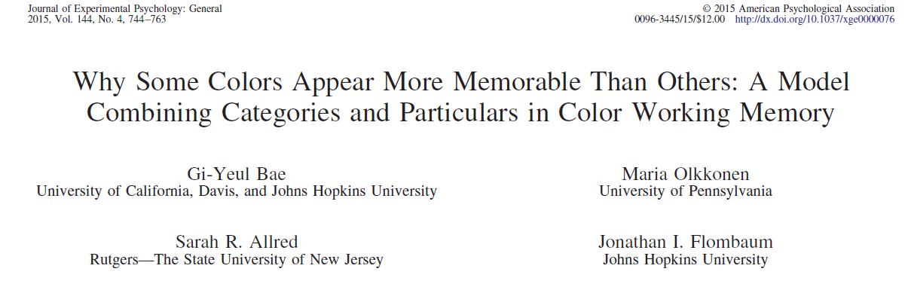
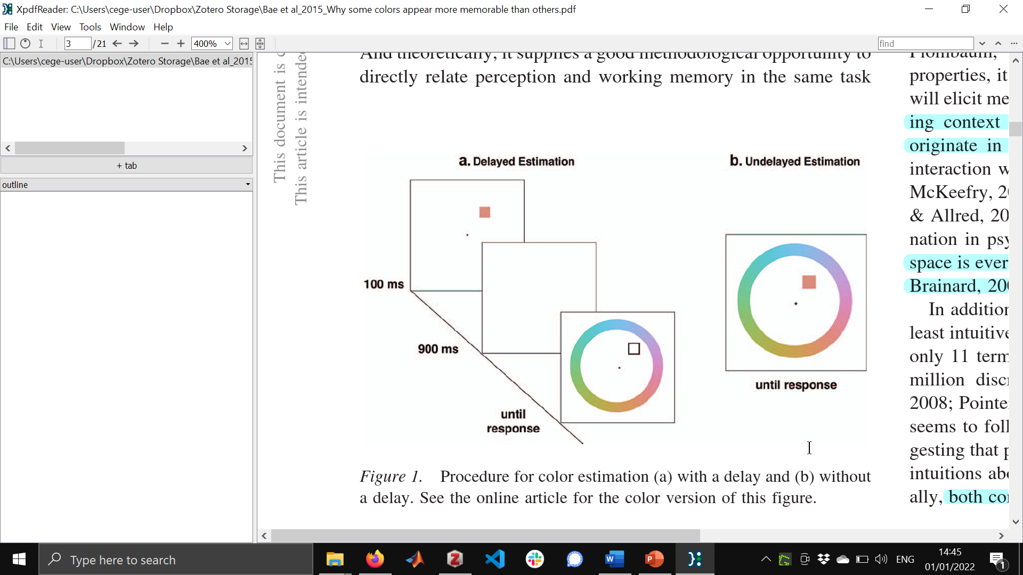
A non-verbal test of color categorization

Slide 2
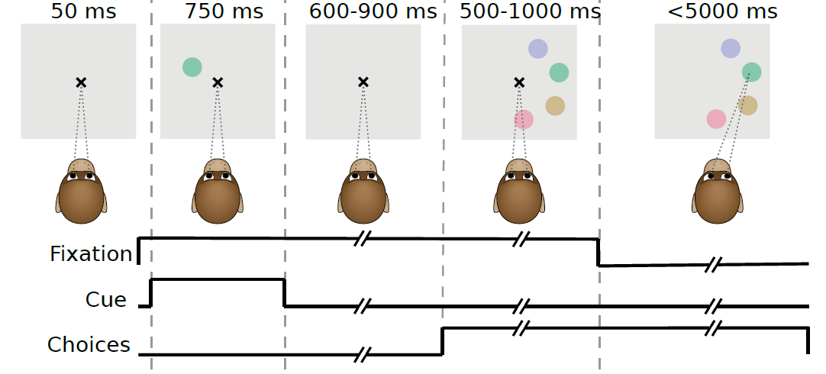
Monkey color categories
Danny Garside
Audrey Chang
Hannah Selwyn
Shriya Awasthi
unpublished

Slide 3
For a given cue, what color does the monkey pick?
anticlockwise
BIAS
0
clockwise

Slide 4
For a given cue, what color does the monkey pick?
anticlockwise
BIAS
0
clockwise
Notes:
These notes.

Slide 5
For a given cue, what color does the monkey pick?
anticlockwise
BIAS
0
clockwise

Slide 6
For a given cue, what color does the monkey pick?
anticlockwise
BIAS
0
clockwise

Slide 7
For a given cue, what color does the monkey pick?
Negative slope captures an attractor at 0 bias
anticlockwise
BIAS
0
clockwise

Slide 8
For a given cue, what color does the monkey pick?
anticlockwise
BIAS
0
clockwise

Slide 9
For a given cue, what color does the monkey pick?
anticlockwise
BIAS
0
clockwise

Slide 10
For a given cue, what color does the monkey pick?
anticlockwise
BIAS
0
clockwise

Slide 11
For a given cue, what color does the monkey pick?
Positive slope captures a repellor at 0 bias
anticlockwise
BIAS
0
clockwise

Slide 12
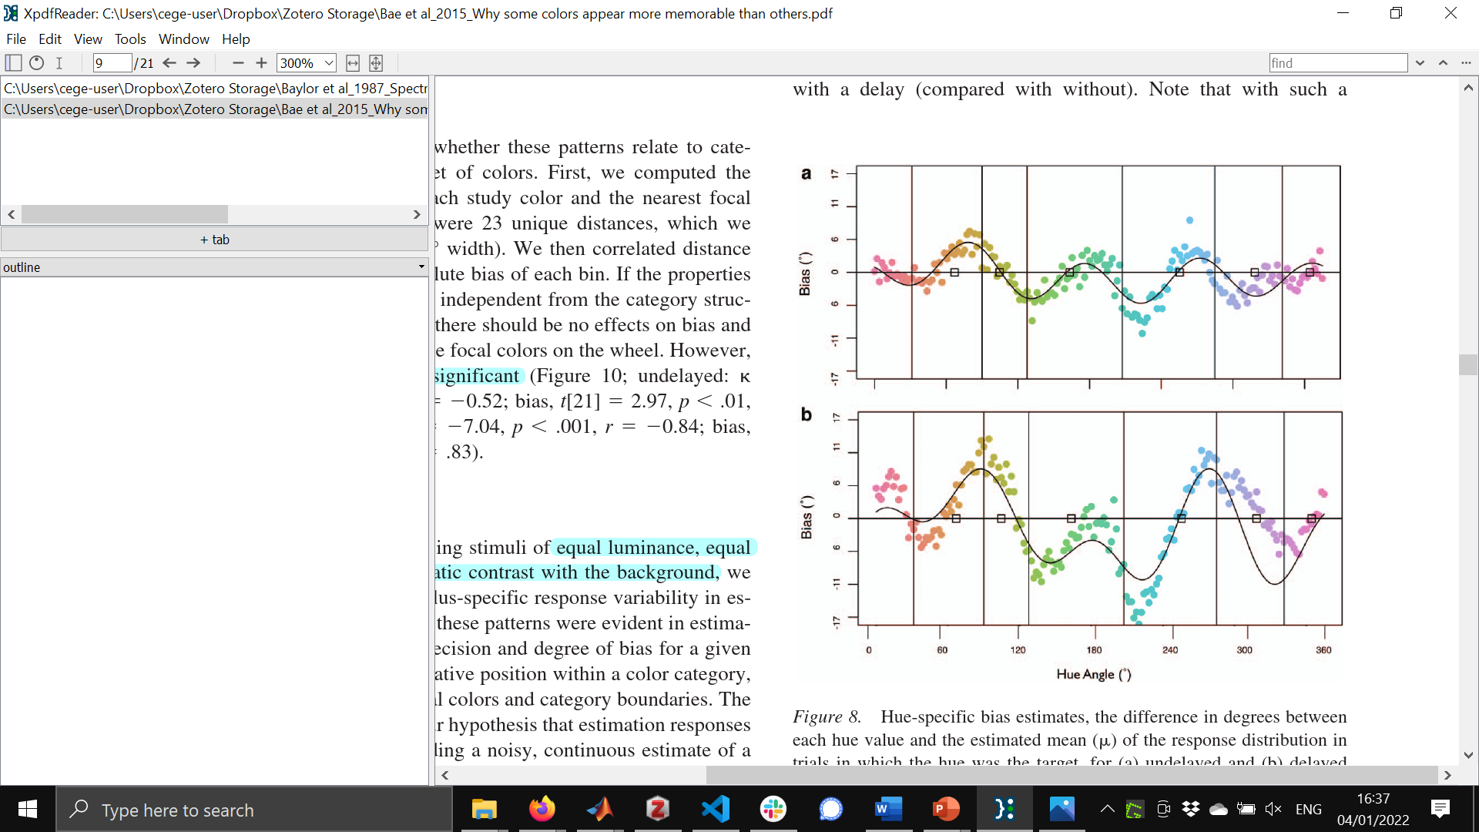
No color categories recovered with this method
Color categories:
predictions
attractor points
Notes:
Bae+ figure is vertically flipped to allow better comparison with our method of plotting (their method of plotting is bad)
Thus, for both graphs, attractor points are zero crossings from positive to negative (and repellor points are zero crossings from negative to positive)
96122 trials
Points are independently fit gaussians
Black line is smoothed
Gray area is smoothed confidence intervals of each point

Slide 13
Four main “basic” colors: red, yellow, green, blue
Color categories:
predictions
attractor points
No color categories recovered with this method
red yellow green blue
Notes:
Bae+ figure is vertically flipped to allow better comparison with our method of plotting (their method of plotting is bad)
Thus, for both graphs, attractor points are zero crossings from positive to negative (and repellor points are zero crossings from negative to positive)
96122 trials
Points are independently fit gaussians
Black line is smoothed
Gray area is smoothed confidence intervals of each point

Slide 14
attractor points
Cone-opponent colors
Color categories:
predictions
No color categories recovered with this method
-S M-L +S L-M
Notes:
Bae+ figure is vertically flipped to allow better comparison with our method of plotting (their method of plotting is bad)
Thus, for both graphs, attractor points are zero crossings from positive to negative (and repellor points are zero crossings from negative to positive)
96122 trials
Points are independently fit gaussians
Black line is smoothed
Gray area is smoothed confidence intervals of each point

Slide 15
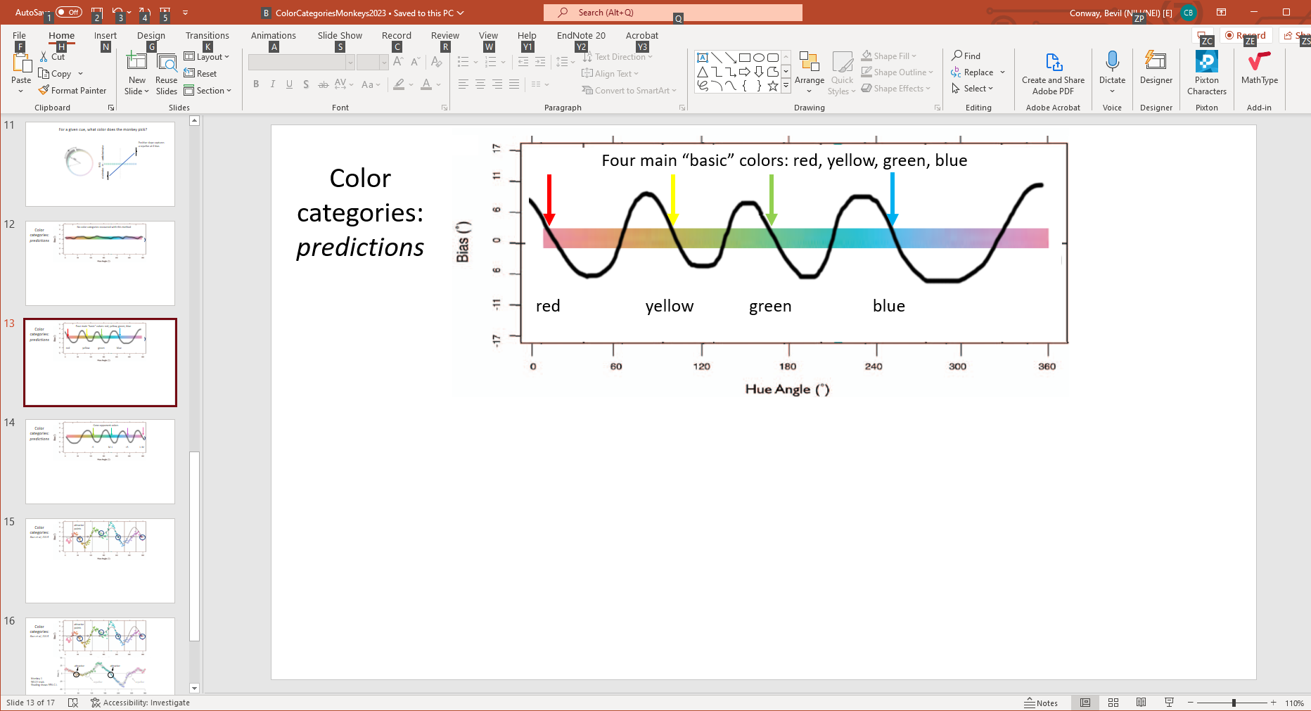
Color categories:
Bae et al, 2015
attractor points
Notes:
Bae+ figure is vertically flipped to allow better comparison with our method of plotting (their method of plotting is bad)
Thus, for both graphs, attractor points are zero crossings from positive to negative (and repellor points are zero crossings from negative to positive)
96122 trials
Points are independently fit gaussians
Black line is smoothed
Gray area is smoothed confidence intervals of each point

Slide 16
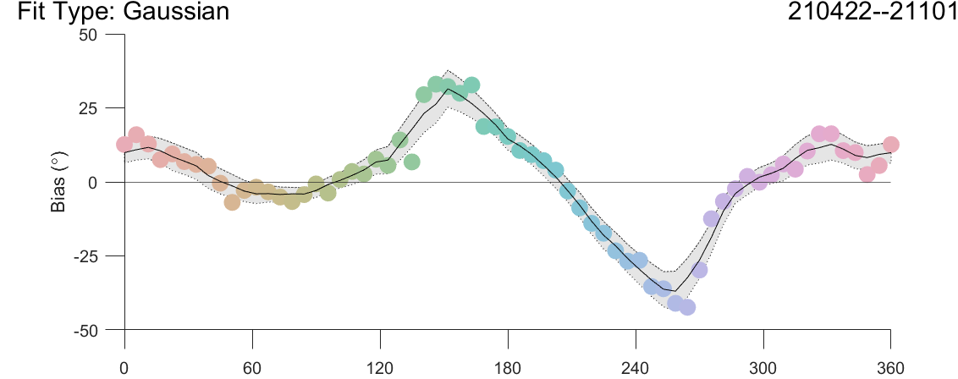
Color categories:
Bae et al, 2015
attractor points
attractor
attractor
Monkey 1
96122 trials
Shading shows 95% C.I.
repellor
repellor
unpublished
Notes:
Bae+ figure is vertically flipped to allow better comparison with our method of plotting (their method of plotting is bad)
Thus, for both graphs, attractor points are zero crossings from positive to negative (and repellor points are zero crossings from negative to positive)
96122 trials
Points are independently fit gaussians
Black line is smoothed
Gray area is smoothed confidence intervals of each point

Slide 17
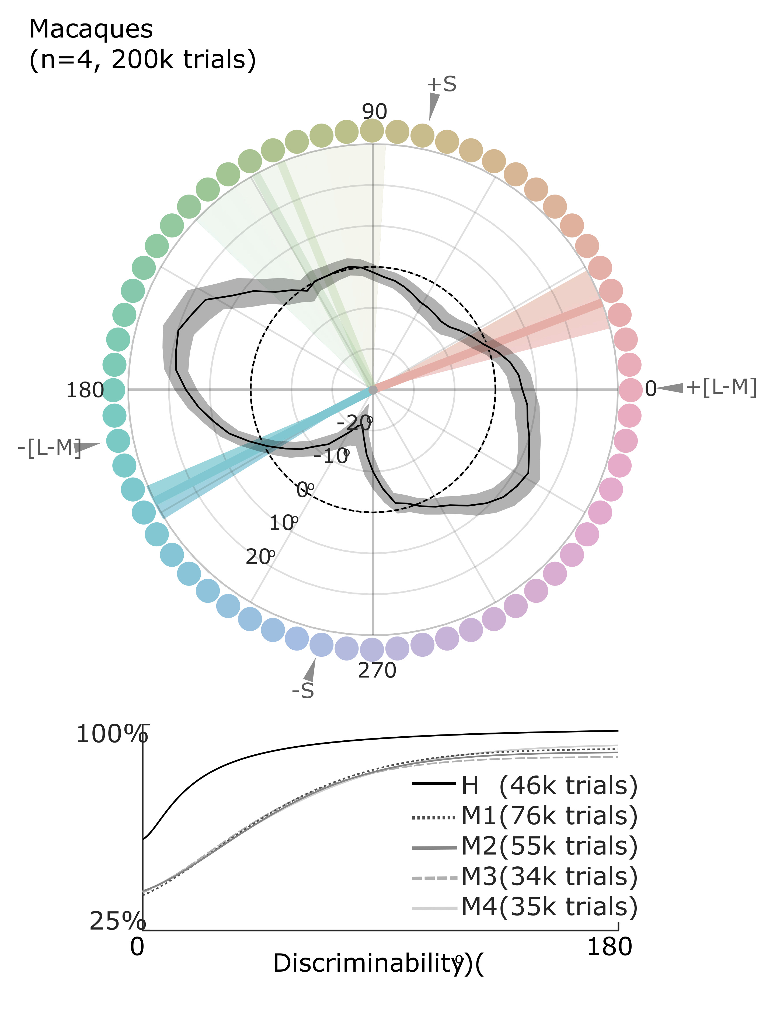
Monkeys appear to have two consensus color categories
choice
Color Difference (degrees)
(cue minus choice)
unpublished

